Slide 1
Strategic Information Systems Management Section 9 Social Computing: How should it be managed? Class Code: COMP423 H.Y Kan, Stanley Room: (WUI CHI) - 4/F, N46B Email: hykan@ipm.edu.mo Tel: 8599-6883

Slide 2
Introduction
For the past several decades, large organizations have been in the forefront of deploying new technologies, but in recent years, some IT managers have noticed that they are no longer on the leading edge of technology usage.
With the mutual maturation of the personal computer and the Internet, the “bleeding edge” has been taken over by individuals who are persistently finding new and different ways to use technology for their personal benefit.
Interpersonal computing applications enabled by the Internet have considerable strategic potential if they can be effectively managed.
To examines our current understanding of social computing in organizations, describes the concept and provide a brief introduction to the different computing that can be referred to by this label.

Slide 3
What is Social Computing?
Social computing denotes the hardware, software, and applications that support any sort of social behavior.
Social computing is designed to create or re-create “social conventions and social contexts”.
Notes:
Social computing denotes the hardware, software, and applications (including social network and web 2.0 software) to support any sort of social behavior and enables people to us computing devices to interact with one another or communicate through .

Slide 4
What is Social Computing? Continued
Cheap connectivity devices
Cellphones, Blackberries, iPods, laptops
P2P communication
Direct connectivity between two or more users, without mediation
Web 2.0 applications
Platforms that stress interaction and mass participation (e.g., wikis, Facebook, MySpace)
Computing behavior
It’s creating new relationships and power structures

Slide 5
What’s Driving Social Computing In Organizations?
Some companies are approaching social computing very cautiously “because they have been fooled in the past by promises of collaboration tools.”
Drivers behind social computing in organizations:
Today’s reality: Cheap devices, anywhere/anytime connectivity, and Web 2.0 applications are already here and spreading rapidly. Because of its viral nature and network effects, social computing is leaking daily into organizations in a variety of forms.
A natural result is an overlap or blurring of our work and personal worlds.
Tomorrow’s potential: What is unclear is how new computing behaviors and the capabilities enabled by new technology will affect the nature of work and shape consumer behavior.

Slide 6
What’s Driving Social Computing in Organizations? Today’s Reality
Globalization and outsourcing are driving new demands of collaboration.
A mobile, customer-facing and virtual workforce expects appropriated collaborative technology.
Wikis and blogs are rewriting the rules of corporate communication (Mayfield 2008).

Slide 7
What’s Driving Social Computing in Organizations? Tomorrow’s Potential
Innovation. Social computing is engaging employees, customers, and suppliers, which may lead to new ways of innovating.
Training. Virtual worlds (e.g., Second Life) create effective distance learning environments and make work more fun.

Slide 8
The Value of Social Computing
Finding the person who knows the answer: Social computing can reduce the time and cost required to find the right person. Social computing offers a profile service for people to publish their expert knowledge and organizational information. They may even include their hobbies and provide links to published contents and current projects.
Working within communities to get things done: Social computing builds business communities that cut across departments and geographies. Within communities, people can find and learn from each other quickly.
Increasing organizational memory: Social computing lets organizations preserve tacit knowledge and share it through various communities. It also gives new team members instant access to documented knowledge and to previous communications, team-member profiles, and timelines of social interactions that have occurred.

Slide 9
The Value of Social Computing (Cont’d)
Attracting and retaining talents: In a social organization, communities are fluid and self-governing; that is, communities form around relevant interests and objectives of employees, who can choose to what degree they want to participate. These kinds of learning opportunities and dynamic channels of engagement attract top talent. And employees are more likely to stay longer at an organization that provides means and ways for enhanced participation and stronger engagement within the organization.
Improving sales and service: Basically, there are two core capabilities that social computing can influence within sales and service: listening for brand sentiment and amplifying an organization’s message.

Slide 10
Case Studies

Slide 11
Organizational Implications
More flexible organizational behavior: Most social computing applications share the following characteristics:
Dynamic Participation - through contribution and feedback
Openness in a variety of ways, such as voting, feedback, sharing information and comments
Conversation
Community building by enabling those with a common interest to connect and communicate effectively

Slide 12
Organizational Implications (Cont’d)
New ways to manage digital contents:
Social computing applications offer new ways of searching, managing, and effectively utilizing digital contents.
A variety of social computing applications are designed for improved information management. RSS feeds, improved search tools, tagging, blogs, personal home pages, and virtual worlds are some of the tools that will give information context and make it easier to find and use in the future.

Slide 13
Organizational Implications (Cont’d)
New styles of management:
In the past, organizations have forbidden the personal use of such technologies as telephones and the Internet and, now, social computing, the trend is toward an environment where we are always available to both our work and personal lives. This will necessitate a change of management style and metrics.
“ We need to focus more on people’s outputs. We don’t live in a clocking-in environment anymore. We should care about what people deliver and their accountabilities.”
This suggests that employers will have to trust their staff in situations where they are unsupervised and that employees will have to inculcate organizational values and expectations and be expected to apply them appropriately wherever they are.

Slide 14
Organizational Implications (Cont’d)
Adaptive organizational designs:
The effect of the above changes will mean a shift in how organizations function.
Organizations will become more open and flexible. Many traditional organizational boundaries will be broken down and that there will be less structure and greater agility in a variety of areas:
Roles people play will tend to be situational rather than fixed.
Flatter structures with fewer layers of control.
More reliance on other forms of control (e.g., deliverables, accountabilities, ethics and audits)
The breaking down of traditional internal boundaries between business units.
Continuously evolving business models and sources of value.
It is likely that new organizational designs will combine the best of traditional approaches to management and value creation with new control, accountability, and decision-making mechanisms.

Slide 15
Organizational Implications (Cont’d)
Most companies currently have no policies governing the acceptable use of social computing and some even deny their employees access to these tools.
Major changes anticipated:
Innovation will move from a top-down to a bottom-up model
Value will move from ownership to experiences
Power will shift from institutions to communities

Slide 16
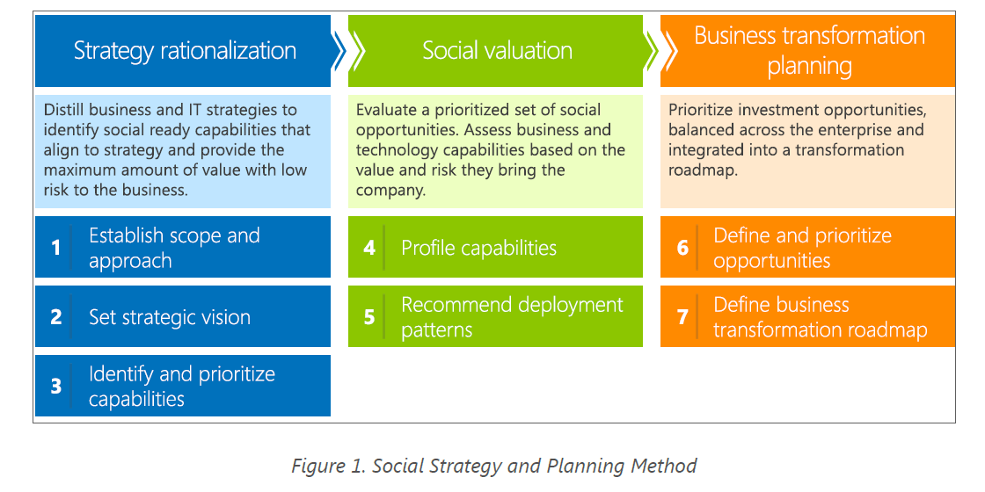
Creating a Social Computing Strategy

Slide 17
Creating a Social Computing Strategy (Cont’d)
Strategy Rationalization:
Different industries and departments may have different implementation focus and strategy.
Defining the scope of a social initiative helps craft a focused and effective vision, which provides aspirational statements of positive outcomes that will come from investing in social computing.
The vision statement should clearly define who will benefit from the initiative, describe the social activities and behaviours that are desired, and detail the benefits that the organization hopes to gain from it.

Slide 18
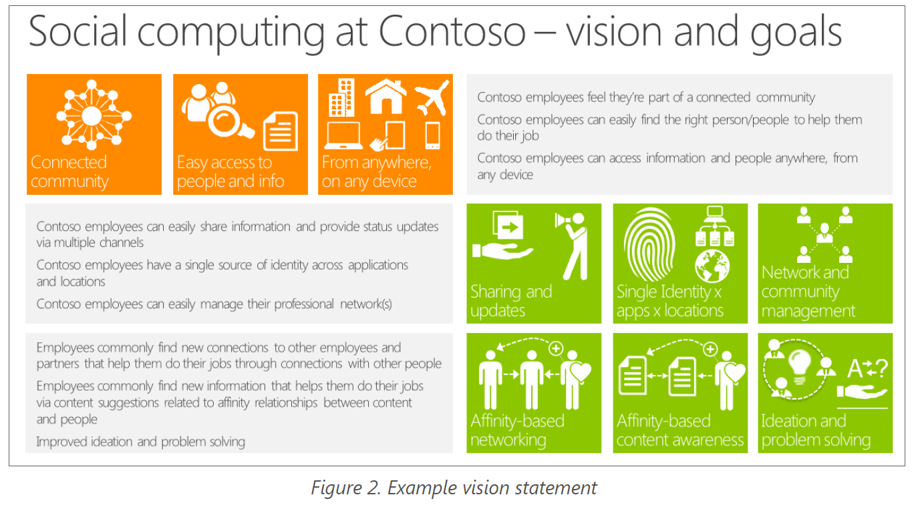
Creating a Social Computing Strategy (Cont’d)

Slide 19
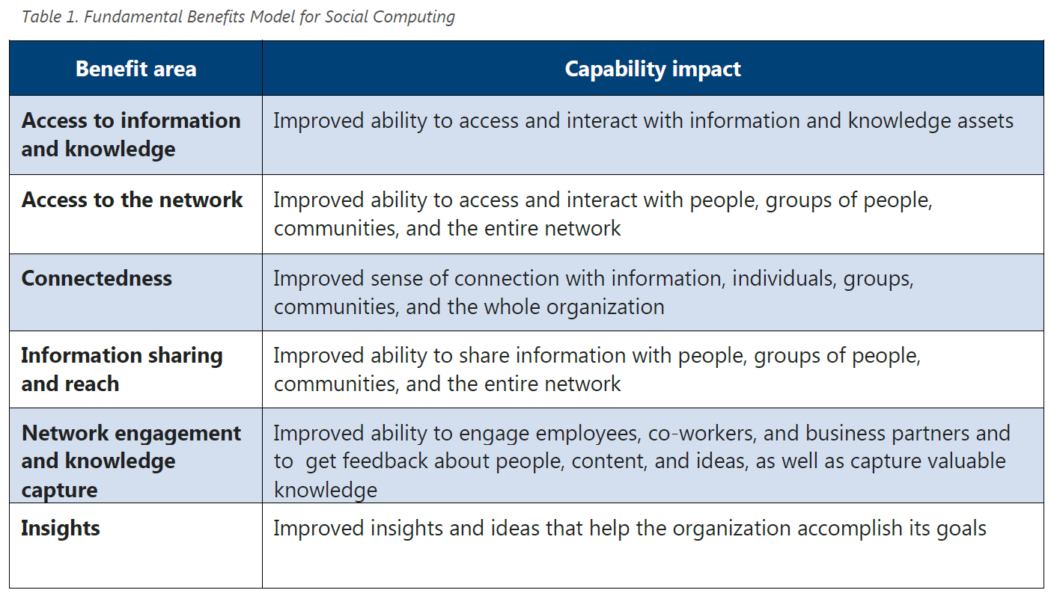
Creating a Social Computing Strategy (Cont’d)
Social valuation:

Slide 20
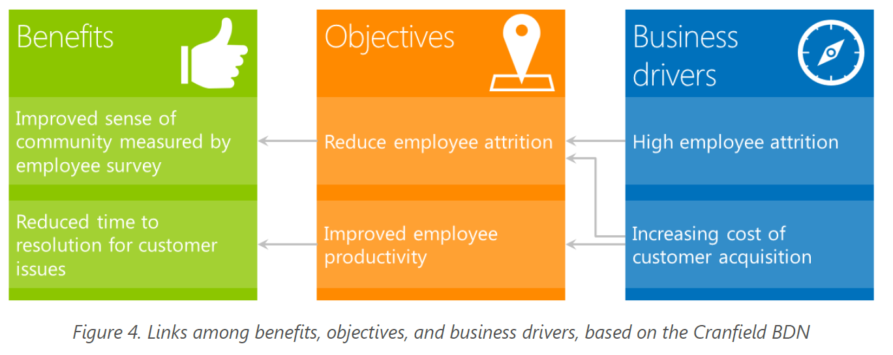
Creating a Social Computing Strategy (Cont’d)
Social valuation (cont’d):
Different organizations may focus on different benefit areas but the key is to tie the targeted benefits to the organization’s business objectives and then to tie the business objectives to the business drivers that affect the organization.

Slide 21
Creating a Social Computing Strategy (Cont’d)
Business transformation planning:
Understand how individuals start out as consumers and gradually become a co-creater. The phases involved are:
Consume: Weak connection to the community, success is when something is found that’s useful, largely monitoring incoming information.
Convey: Early blogs, micro-blogs, and posts to express and share interests, opinions and trends.
Connect: Discover and share with others who have a common interest.
Cooperate: Form affiliations and align actions toward a common goal.
Co-create: Shape and joint solution or creation.

Slide 22
Creating a Social Computing Strategy (Cont’d)
Business transformation planning (cont’d):
Create usage scenarios to bring vision to life and to assess the people, business and technology capabilities that are required to enable them.
Assess the current state of the computing environment and perform a gap analysis.
Be aware of organization cultural issues.
Establish policies and incentives to motivate sharing of knowledge.
Examples: gamification, social rewards such as badges and employee recognition.

Slide 23
The Challenge for IT Managers
“Social computing is a challenge in our locked down environment. Our information security principles conflict with social computing.”
“We need to change but we also need to protect our corporate assets. We really need to be developing policies for how to do this.”
Short business horizons: As has often seen in the past, business leaders have a much shorter time horizon in their thinking than IT and are often not prepared to anticipate or explore new technologies and their implications. Then, when the technology hits public awareness, they want it yesterday!
Resources: Social computing is touted as an effective collaboration and innovation tool but using it for this purpose requires support and facilitation.

Slide 24
The Challenge for IT Managers (Cont’d)
Changing the culture: IT managers recognize that organizational behavior must change if the value of social computing is to be realized. However, changing embedded cultural practices is often extremely difficult. Even where there is a strong emphasis on making information and people more accessible, social computing needs a champion to make sure “we don’t slip back into our comfortable ways of behaving.”

Slide 25
Preparing for the Future
Preparing to embrace social computing:
Experimentation: Work on small-scale social computing experiments to gain experience and better understand their implications. These experiments include internal wikis and blogs to a corporate presence in Second Life to support instant massaging.
Practice evolution: One goal of experimentation is to figure out how to manage social computing effectively based on experience. For example, existing codes of conduct for Internet usage can be adapted to social computing.
Vision: It is important to work toward a common vision for social computing in a particular organization. Some factors that may affect the vision include demographics of the workforce, company partners, suppliers and customers; the degree to which the industry is regulated; the importance of creativity and innovation in the business; the organization’s capability for change and management’s willingness to champion, source, and support new ways of working.

Slide 26
The Challenge of Social Computing: IT Manager’s Perspective
The Vision | The IT Manager’s Challenge
Blurred boundaries Collaboration and sharing Situational applications Mass participation and accessibility Transient information Supports social behavior Innovation and creativity Viral Dynamic Situational roles Social governance and etiquette Collective intelligence; bottom-up innovation Anywhere/anytime connectivity | Firewalls Intellectual property and privacy protection Maintaining transactional applications and operational integrity Authentication and authorization Creating a permanent record Support business behavior Efficient use of resources Secure Backup Regulatory accountabilities Organizational governance and policy Top-down business strategy Controlled communication

Slide 27
Three Constant Questions about Social Computing
What is the value of these tools?
How can we pick the right ones?
What is the management playbook for using them effectively?
There are no final answers yet but:
Experimenting, practicing, and visioning.

Slide 28
Conclusions
Social computing is a powerful set of technologies, tools, and behaviors, but whether or not that power will be perceived as “valuable” is yet to be seen.
The impact of social computing will result from the deep and close connections created by people and technology.

